Slide 1
Quantitative Finance Research Presentation
Bose Kaikini | Dao Bui

Slide 2
Paper Summary
https://arxiv.org/pdf/2406.12908
What were the research questions and conclusions of the 2024 paper?
Background
Research Questions
1
2
MM-TSFMs had great potential but there was no 3rd-party (no access to dataset) method of systematically rating them for trustworthiness and fragility.
To examine whether this multimodal model was more robust than a traditional one, to build a causal analysis framework and measure perturbation impact on forecasting accuracy.
Methodology
Conclusions
3
4
Employed some causal analysis techniques through specific perturbations to the data to examine impact on the predictions.
The rating system works well and certain types of perturbations (namely sentiment) are much more damaging to the time series prediction.

Slide 3
Company Name
The Quantum Leap in Banking
Year/Quarter/Month
Quantum computing is heavily involved with the future of finance, and that future is coming fast. Large banks and companies like HSBC and IBM lead the charge with a number of smaller quantum startups that are actively looking to integrate quantum technologies into portfolio optimization, asset management, and fraud detection. In general, quantum technologies help accelerate the process of complex and time consuming tasks within finance. McKinsey recommends targeted approaches through scalable pilot projects while the technology grows more accurate and integrable. Banks can begin to position themselves for the next wave of quantum computing through building a quantum action plan, collaboration with the quantum community, and small scaled, strategic projects.
McKinsey estimates $400–600 billion in value by 2035 from quantum finance.
Banks used quantum machine learning to improve fraud detection and churn prediction accuracy
Citi and Classiq piloted quantum algorithms for portfolio optimization

Slide 4
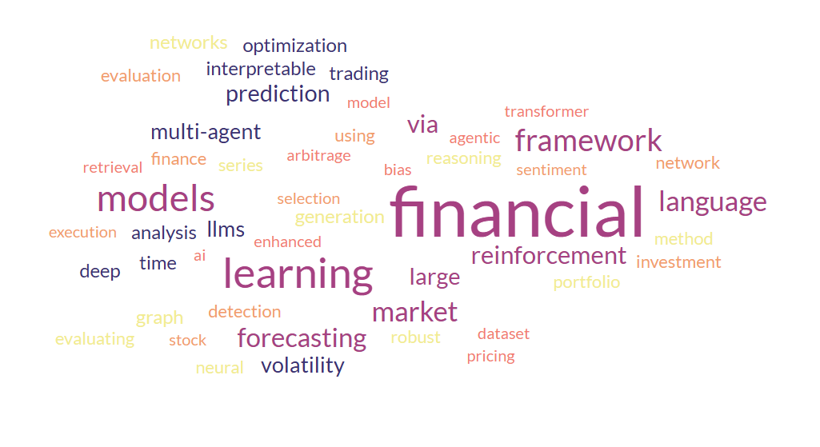
ACM ACAIF 2025 Word Cloud

Slide 5
Quantum Analog of 2024 ViT-numSpec
Classical
Quantum
Steps
Change 1
1-Dimensional Financial Data (begins the pipeline and feeds into the Spectrogram and Time Series Graph)
More robust model by allowing for superposition (can handle complex relationships)
Amplitude encoding or related technique to map into some Hilbert space
Deal with perturbations
Change 2
Visual and Numerical Data are both weighted in the final causal forecasting model
Takes the multimodal model to the next level
Entangles the visual and numerical data
Design a custom circuit to enable this fusion method
Change 3
Weights are iteratively calculated
Speedup through faster computation
Simultaneous adjustment of parameters through quantum parallelism
Qubit errors
https://arxiv.org/pdf/2406.12908

Slide 6
Areas of Interest & Next Steps
Quantum Portfolio Optimization – Uses quantum algorithms to solve complex asset allocation problems faster than classical methods.
GNN Anomaly/Arbitrage Detection Model – Applies graph neural networks to detect abnormal volatility and momentum patterns across interconnected assets.
Quantum Superposition Monte Carlo Speedup – Leverages quantum superposition to accelerate Monte Carlo simulations for pricing and risk analysis.
Quantum Markov Chain – Models probabilistic market state transitions using quantum-enhanced Markov processes.
We’d also want to discuss specifics such as: meeting times, time commitment (hrs/wk), deadlines, presentations, connections, compensation, publications, and anything that may aid us in our research careers.
We’d also like to express our excitement for working in this field with you on any of these topics or any other idea/application of your KMC methods in the finance space.

